Slide 1
Consumer Sentiment Prediction oneAPI
BlackBird
Ashish Anil Waykar

Slide 2
Guidelines
Your pitch time is for 10 Mins.
This included 7 mins of presentation and 3 mins of Q&A.
The presentation will be virtual
Keep it crisp, clear and concise.
Core components of oneAPI/SYCL used
Demo is mandatory. (Video or Live demo)
Highlight oneAPI /SYCL usage with Stats.
Don’t overshoot timeline.
After pitch, there will be questions from Jury.

Slide 3
Predict Consumer Sentiment
Step 1 :
Data Analysis And Preprocessed Data.
Step 2 :
Created pipeline for every type of output as per title and headline.
Splitted pipeline as per KNeighborsRegressor & RandomForestRegressor.
Step 3 :
Processed the both model to fit it in pipeline.
Step 4 :
Got the time takes to the complete computations for fitting the model.
Step 5 :
Predicted the data And Acquired the prediction accuracy.

Slide 4
Architecture – Impact of oneAPI/SYCL (How oneAPI /SYCL helped you?)
DAAL4Py Architecture :
DAAL4Py is built on top of the Intel DAAL library, which provides highly optimized algorithms for data analytics.
DAAL4Py provides a Python interface to the Intel DAAL library, which allows Python users to take advantage of the high-performance algorithms in the Intel DAAL library without having to write low-level C++ code.
DAAL4Py is designed to take advantage of Intel processors, which provide hardware acceleration for certain machine learning tasks.
DAAL4Py is designed to be easy to use, with a simple and consistent API that is similar to the scikit-learn API.
With intel DAAL4Py we have an access of several machine learning algorithms that all are mentioned in documentation[1].

Slide 5
Core components of oneAPI used ensemble methods in the project
DAAL4Py Architecture Used For get the Best Accuracies :
daal4py.sklearn.neighbors.KNeighborsRegressor
daal4py.sklearn.ensemble.RandomForestRegressor
daal4py.sklearn.model_selection._daal_train_test_split
SKL Architecture Used For get the Best Accuracies :
sklearn.neighbors.KNeighborsRegressor
sklearn.ensemble.RandomForestRegressor
sklearn.model_selection. train_test_split
XGBOOST
NKTL

Slide 6
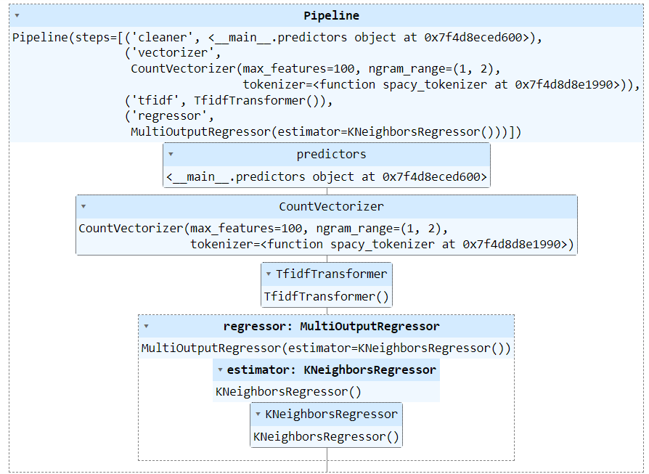
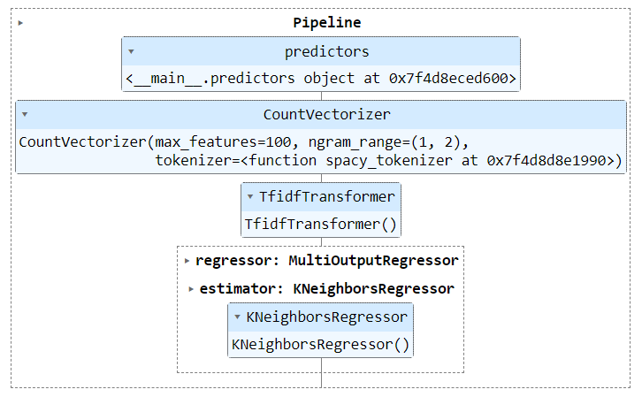
Demo Video/Live Demo Please elaborate oneAPI/SYCL usage
Used Algorithm With Pipeline :
KNeighborsRegressor
Used With Both Scikit learn & DAAL4PY
Used For :
SentimentTitle Prediction KNeighbors
SentimentTitle Prediction Pipeline : SKL & DAAL4PY
With KNeighborsRegressor

Slide 7
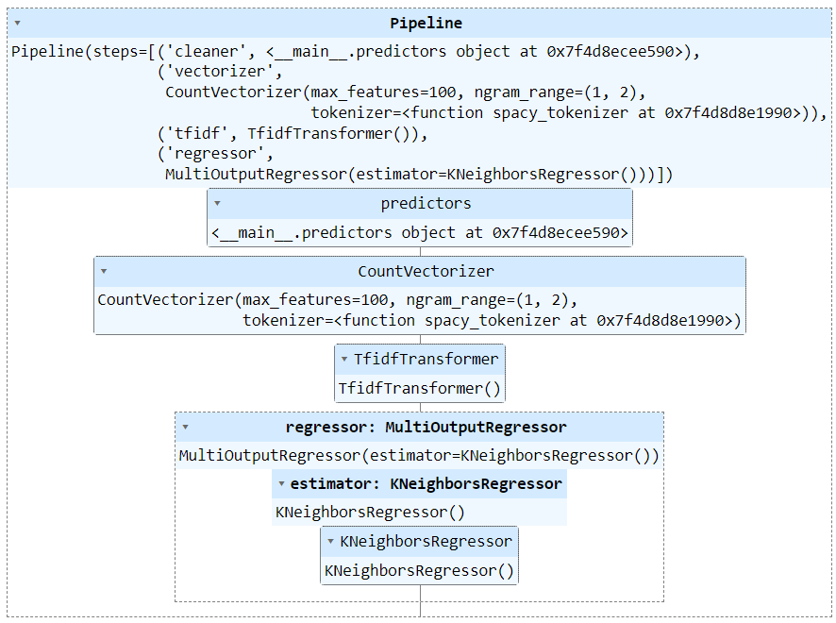
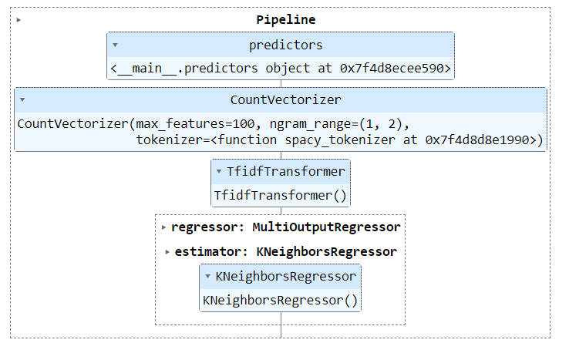
Demo Video/Live Demo Please elaborate oneAPI/SYCL usage
Used Algorithm With Pipeline :
KNeighborsRegressor
Used With Both Sikit learn & DAAL4PY
Used For :
SentimentHeadline Prediction KNeighbors
SentimentHeadline Prediction Pipeline : SKL & DAAL4PY
With KNeighborsRegressor

Slide 8
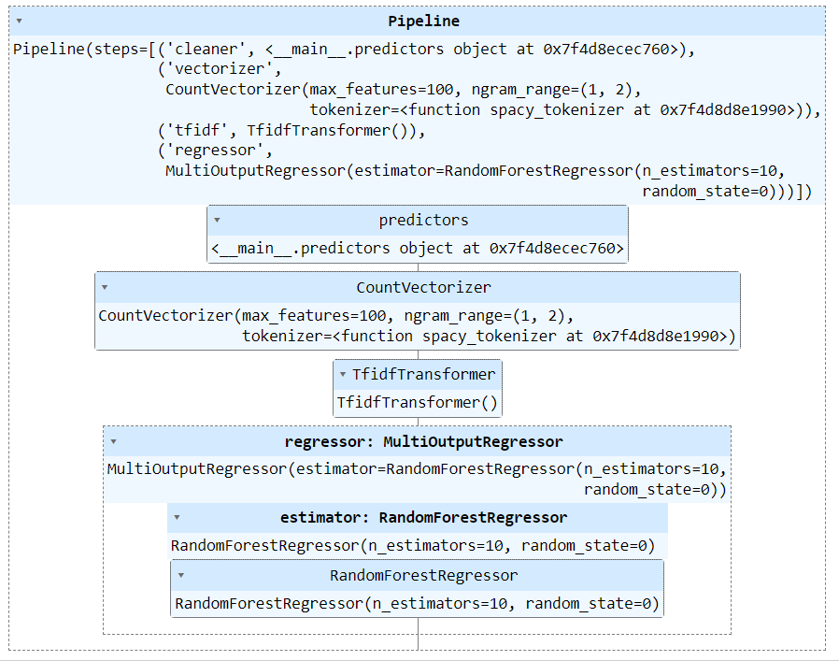
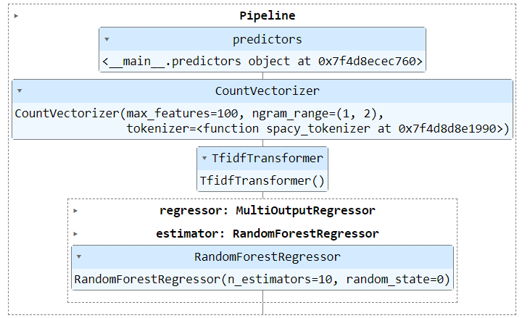
Demo Video/Live Demo Please elaborate oneAPI/SYCL usage
Used Algorithm With Pipeline :
RandomForestRegressor
Used With Both Sikit learn & DAAL4PY
Used For :
SentimentTItle Prediction Randomforest
SentimentTitle Prediction Pipeline : SKL & DAAL4PY
RandomForestRegressor

Slide 9
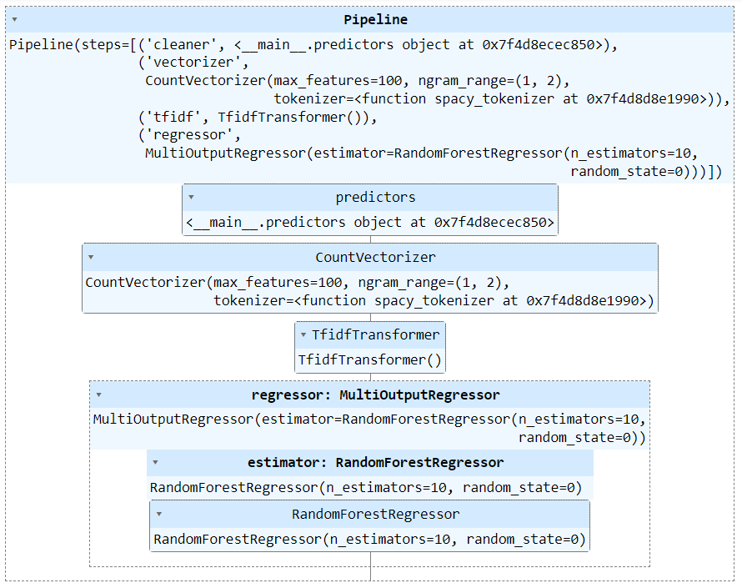
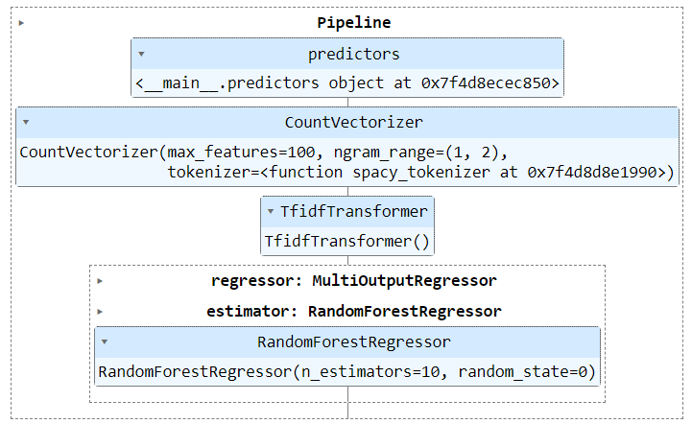
Demo Video/Live Demo Please elaborate oneAPI/SYCL usage
Used Algorithm With Pipeline :
RandomForestRegressor
Used With Both Sikit learn & DAAL4PY
Used For :
SentimentHeadline Prediction Randomforest
Sentiment Headline Prediction Pipeline : SKL & DAAL4PY
RandomForestRegressor

Slide 10
GitHub Link(Codes should be public and available after hackathon also)
Round 2 :
Github [1]:
https://github.com/Ashish-Waykar/INTEL-OneApi/blob/main/oneapi-sentiment-prediction%20finaized%20(3).ipynb
Github [2]:
https://github.com/Ashish-Waykar/Consumer-Sentiment-Prediction-System/blob/main/OneAPI.ipynb
Dataset Raw :
https://raw.githubusercontent.com/Ashish-Waykar/DSA/main/training_data_sentiment.csv

Slide 11
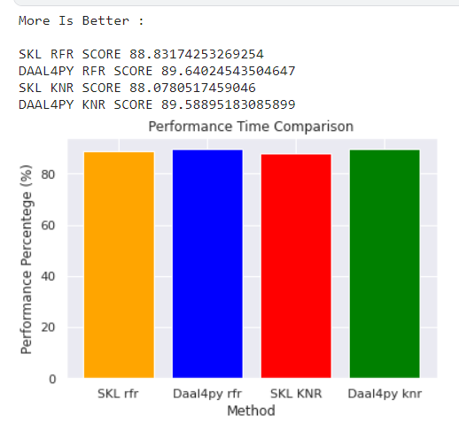
Results Summary(focus on unique aspects of oneAPI/SYCL that you have used)
Used Algorithms With Comparisons Output Accuracy :
RandomForestRegressor : SKL & DAAL4PY
KNeighborsRegressor : SKL & DAAL4PY
Output Formats Predictions :
SentimentTitle Prediction : SKL & DAAL4PY
SentimentHeadlinePrediction : SKL & DAAL4PY
Performance Comparison daal4py & Sklearn

Slide 12
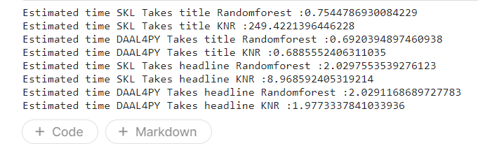
Results Summary(focus on unique aspects of oneAPI)
Used Algorithms With Comparisons Output Accuracy :
RandomForestRegressor & KNeighborsRegressor
Used Algorithms With Comparisons Output Accuracy :
RandomForestRegressor : SKL & DAAL4PY
KNeighborsRegressor : SKL & DAAL4PY
Output Formats Predictions :
SentimentTitle Prediction : SKL & DAAL4PY
SentimentHeadlinePrediction : SKL & DAAL4PY
Performance Comparison With Respect To Time daal4py & Sklearn

Slide 13
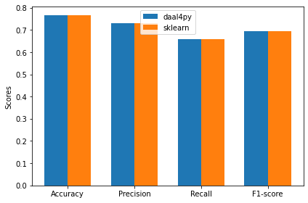
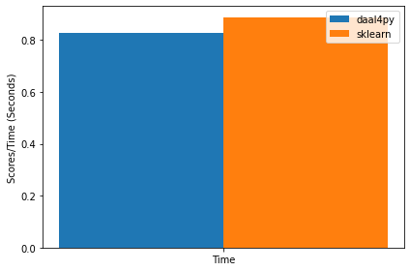
Results Summary(tried to compare output with respect to time and performance)
Performance Comparison With Respect To Time daal4py & Sklearn
Performance Comparison daal4py & Sklearn

Slide 14
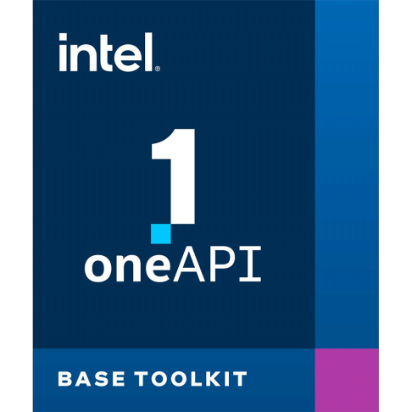

Refferances
ONEAPI:
https://www.intel.com/content/www/us/en/developer/articles/release-notes/distribution-for-python-release-notes.html
daal4Py https://intelpython.github.io/daal4py/algorithms.html https://intelpython.github.io/daal4py/sklearn.html#scikit-learn-api https://intelpython.github.io/daal4py/index.html https://intelpython.github.io/daal4py/scaling.html#supported-algorithms-and-examples
SikitLearn : https://scikit-learn.org/stable/modules/generated/sklearn.neighbors.KNeighborsRegressor.html
https://scikit-learn.org/stable/modules/generated/sklearn.ensemble.RandomForestRegressor.html
https://xgboost.readthedocs.io/en/stable/python/python_api.html
https://scikit-learn.org/stable/modules/generated/sklearn.base.TransformerMixin.html
https://scikit-learn.org/stable/modules/generated/sklearn.feature_extraction.text.TfidfVectorizer.html
https://scikit-learn.org/stable/modules/generated/sklearn.feature_extraction.text.TfidfTransformer.html
https://scikit-learn.org/stable/modules/generated/sklearn.feature_extraction.text.HashingVectorizer.html

Slide 15
Thank you

